Slide 1
Graph Convolution NN
Ruili Feng
University of Science and Technology of China

Slide 2
Outline
Part 0: GCN的发展经过
Part 1: Spectral方法
Spectral Graph Theory
Graph convolution
Graph coarsening
Spectral ConvNets
Part 2: Spatial方法
Part 3: GCN与transfer learning

Slide 3
Outline
Part 0: GCN的发展经过
Part 1: Spectral方法
Spectral Graph Theory
Graph convolution
Graph coarsening
Spectral ConvNets
Part 2: Spatial方法
Part 3: GCN与transfer learning

Slide 4

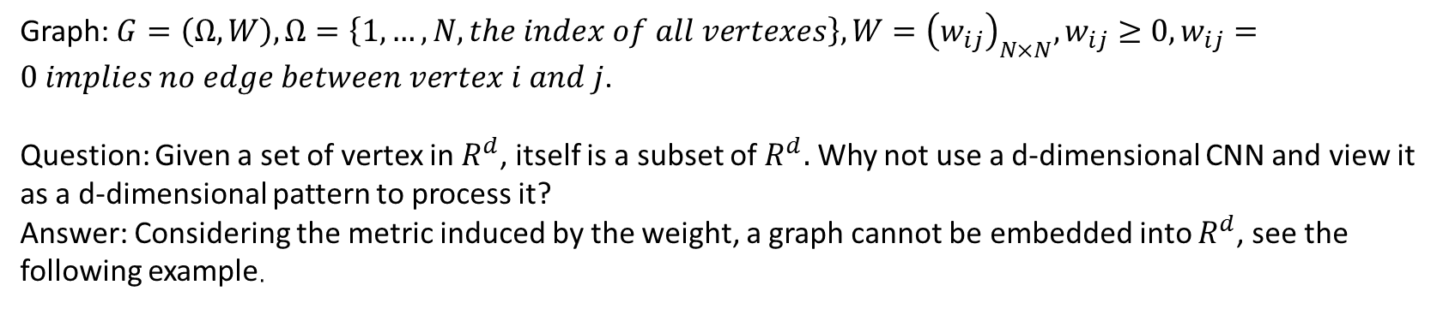


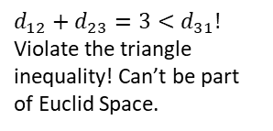




Why GCN?
Graph: $G=\left(Ω,W\right),Ω=\left\{1,…,N, the index of all vertexes\right\},W={\left(w_{ij}\right)}_{N×N},w_{ij}≥0,w_{ij}=0 implies no edge between vertex i and j$.
Question: Given a set of vertex in $R^{d}$, itself is a subset of $R^{d}.$ Why not use a d-dimensional CNN and view it as a d-dimensional pattern to process it?
Answer: Considering the metric induced by the weight, a graph cannot be embedded into $R^{d}$, see the following example.
1
1
Build metric $d_{ij}=\frac{1}{w_{ij}}$
$d_{12}+d_{23}=3<d_{31}!$ Violate the triangle inequality! Can’t be part of Euclid Space.
$$w_{31}=\frac{1}{4}$$
$$w_{12}=1$$
$$d_{31}=4$$
$$d_{12}=1$$
3
2
3
$$w_{23}=\frac{1}{2}$$
2
$$d_{23}=2$$
The main difficulty of feature extraction comes from the complex metric structure
Notes:
Metric is important, in a word, metric decides pattern. Think about the difference between different people’s appearances, they share common abstract features, but the distance and size of them make they look different.

Slide 5
GCN的发展
Citations/ per year
0
50
100
150
250
500
Spectral 方法
Spectral network（NIPS2014）
图卷积
缩小卷积核响应范围；规避Laplace矩阵分解
The emerging field of signal processing on graphs(signal processing magazine2013)
K次多项式滤波
Chebnet
(NIPS2016)
1邻域展开；
重规范邻接矩阵
1stChebnet
(ICLR2017)
GCN
简单特例
用同一函数反复迭代获取稳态
Gated GNN（2016ICLR）
随机更新；
异步并行化
SSE
(ICML2018)
The graph neural network model(2009IEEETransactions on neural networks)
消除压缩映射限制
传递邻域及邻边信息
MPNN
ICML(2017)
Spatial 方法
用不同函数汇聚多尺度信息
置换不变性
GraphSage
NIPS(2017)
GCN框架
GCN的三个组成部分：做卷积；做聚类；下采样。
Notes:
The emerge 219，spectral 101，chebnet208，1stchebnet440，the gnn45，gated86，SSE5，MPNN143，graphsage145
0-300，300-600，600-1000，1000-2000，2000-4000，4000-5000

Slide 6
Outline
Part 0: GCN的发展经过
Part 1: Spectral方法
Spectral Graph Theory
Graph convolution
Graph coarsening
Spectral ConvNets
Part 2: Spatial方法
Part 3: GCN与transfer learning

Slide 7
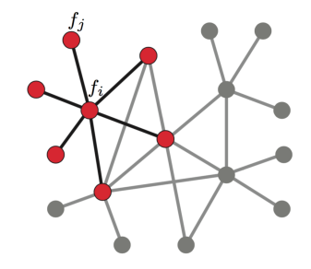
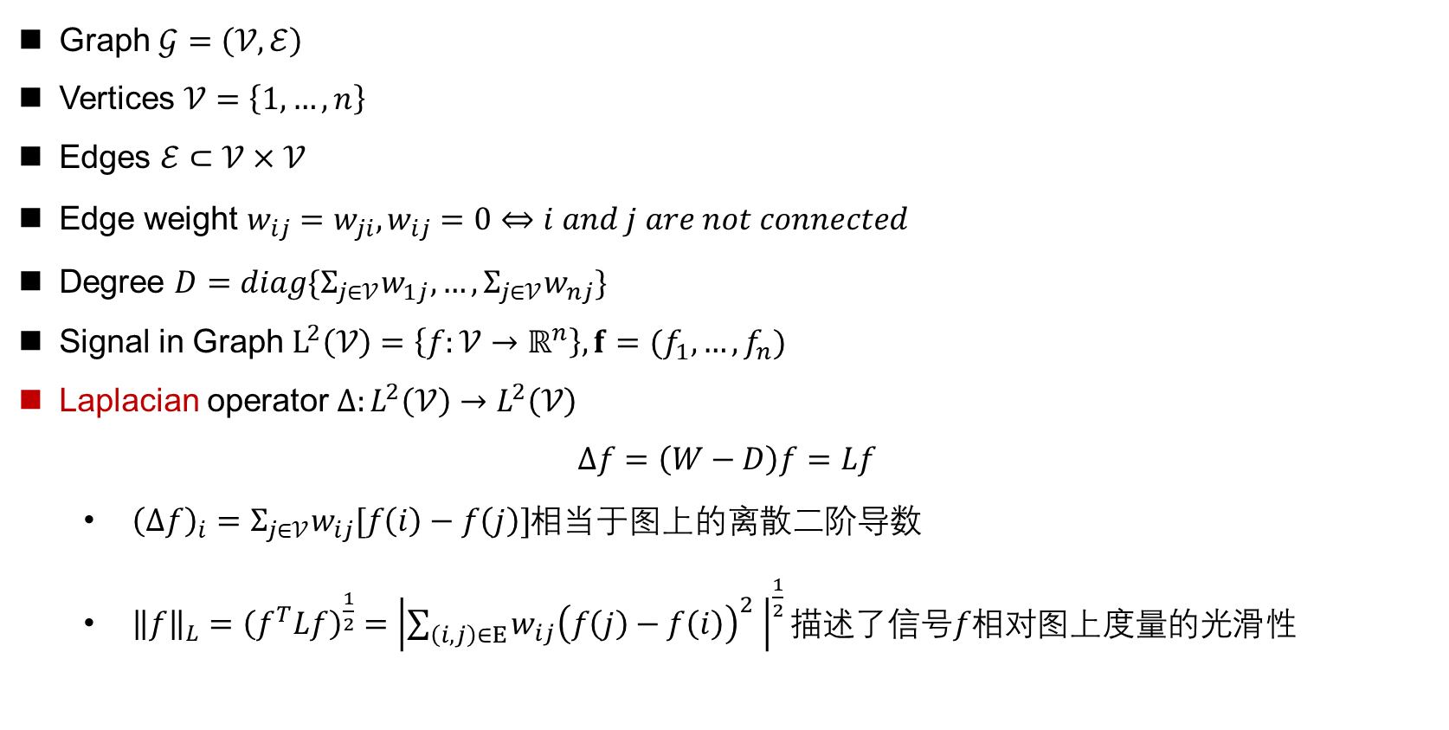
Graphs
Graph $𝒢=\left(𝒱,ℰ\right)$
Vertices $𝒱=\left\{1,…,n\right\}$
Edges $ℰ⊂𝒱×𝒱$
Edge weight $w_{ij}=w_{ji},w_{ij}=0⇔i and j are not connected$
Degree $D=diag\{Σ_{j∈𝒱}w_{1j},…,Σ_{j∈𝒱}w_{nj}\}$
Signal in Graph $L^{2}\left(𝒱\right)=\left\{f:𝒱→ℝ^{n}\right\},f=(f_{1},…,f_{n})$
Laplacian operator $Δ:L^{2}\left(𝒱\right)→L^{2}\left(𝒱\right)$
$$Δf=\left(W−D\right)f=Lf$$
${\left(Δf\right)}_{i}=Σ_{j∈𝒱}w_{ij}[f\left(i\right)−f\left(j\right)]$相当于图上的离散二阶导数
${\left\|f\right\|}_{L}={\left(f^{T}Lf\right)}^{\frac{1}{2}}={\left|\sum_{\left(i,j\right)∈Ε}{w_{ij}{\left(f\left(j\right)−f\left(i\right)\right)}^{2} }\right|}^{\frac{1}{2}}描述$了信号$f相对$图上度量的光滑性
Notes:
Metric is important, in a word, metric decides pattern. Think about the difference between different people’s appearances, they share common abstract features, but the distance and size of them make they look different.

Slide 8
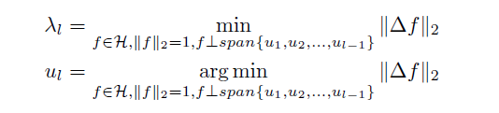
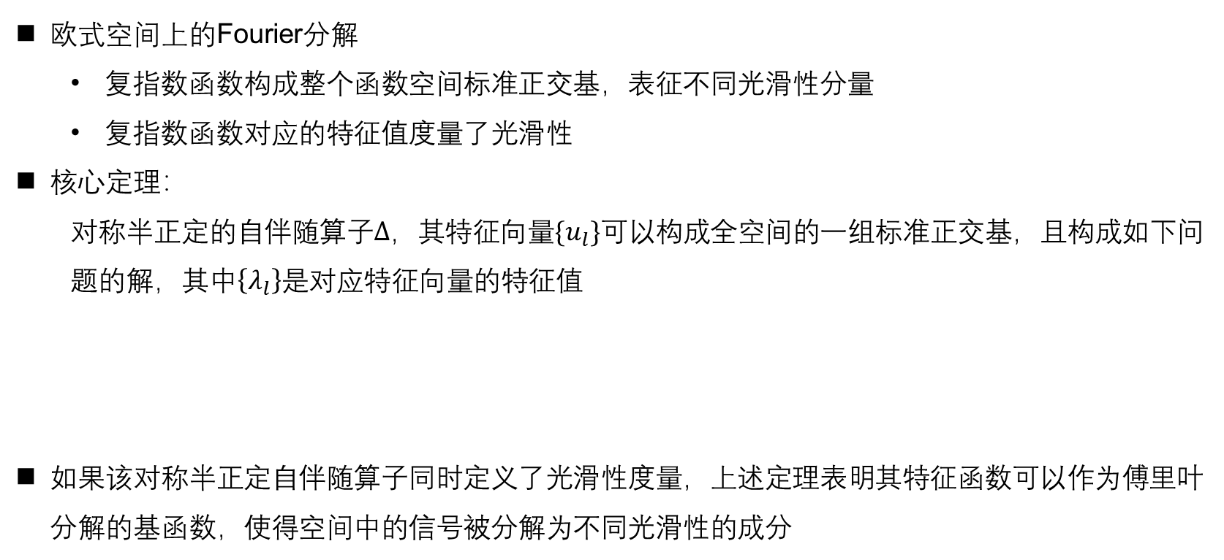
Spectral Fourier decomposition
欧式空间上的Fourier分解
复指数函数构成整个函数空间标准正交基，表征不同光滑性分量
复指数函数对应的特征值度量了光滑性
核心定理：
对称半正定的自伴随算子$Δ$，其特征向量$\{u_{l}\}$可以构成全空间的一组标准正交基，且构成如下问题的解，其中$\left\{λ_{l}\right\}$是对应特征向量的特征值
如果该对称半正定自伴随算子同时定义了光滑性度量，上述定理表明其特征函数可以作为傅里叶分解的基函数，使得空间中的信号被分解为不同光滑性的成分
Notes:
Metric is important, in a word, metric decides pattern. Think about the difference between different people’s appearances, they share common abstract features, but the distance and size of them make they look different.

Slide 9
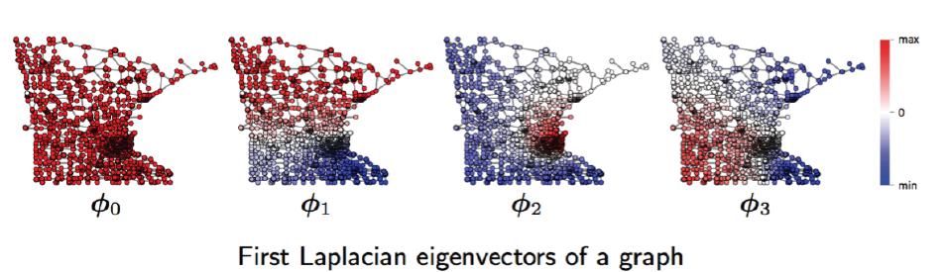

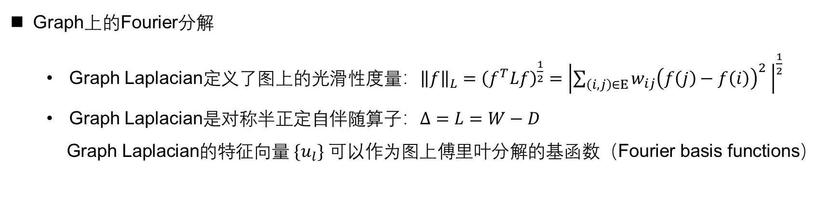



Spectral Fourier decomposition
Graph上的Fourier分解
Graph Laplacian定义了图上的光滑性度量：${\left\|f\right\|}_{L}={\left(f^{T}Lf\right)}^{\frac{1}{2}}={\left|\sum_{\left(i,j\right)∈Ε}{w_{ij}{\left(f\left(j\right)−f\left(i\right)\right)}^{2} }\right|}^{\frac{1}{2}}$
Graph Laplacian是对称半正定自伴随算子：$Δ=L=W−D$
Graph Laplacian的特征向量$\{u_{l}\}$可以作为图上傅里叶分解的基函数（Fourier basis functions）
$$u_{0}$$
$$u_{1}$$
$$u_{2}$$
$$u_{3}$$
Notes:
Metric is important, in a word, metric decides pattern. Think about the difference between different people’s appearances, they share common abstract features, but the distance and size of them make they look different.

Slide 10
Outline
Part 0: GCN的发展经过
Part 1: Spectral方法
Spectral Graph Theory
Graph convolution
Graph coarsening
Spectral ConvNets
Part 2: Spatial方法
Part 3: GCN与transfer learning

Slide 11
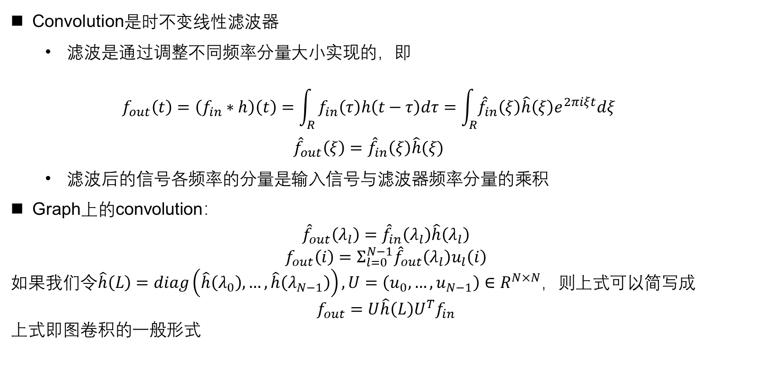
Graph Convolution
Convolution是时不变线性滤波器
滤波是通过调整不同频率分量大小实现的，即
$$f_{out}\left(t\right)=\left(f_{in}∗h\right)\left(t\right)=\int_{R}{f_{in}\left(τ\right)h\left(t−τ\right)dτ=\int_{R}{{\hat{f}}_{in}\left(ξ\right)\hat{h}\left(ξ\right)e^{2πiξt}dξ}}$$
$${\hat{f}}_{out}\left(ξ\right)={\hat{f}}_{in}\left(ξ\right)\hat{h}(ξ)$$
滤波后的信号各频率的分量是输入信号与滤波器频率分量的乘积
Graph上的convolution：
$${\hat{f}}_{out}\left(λ_{l}\right)={\hat{f}}_{in}\left(λ_{l}\right)\hat{h}\left(λ_{l}\right)$$
$$f_{out}\left(i\right)=Σ_{l=0}^{N−1}{\hat{f}}_{out}\left(λ_{l}\right)u_{l}\left(i\right)$$
如果我们令$\hat{h}\left(L\right)=diag\left(\hat{h}\left(λ_{0}\right),…,\hat{h}\left(λ_{N−1}\right)\right),U=\left(u_{0},…,u_{N−1}\right)∈R^{N×N}$，则上式可以简写成
$$f_{out}=U\hat{h}\left(L\right)U^{T}f_{in}$$
上式即图卷积的一般形式
Notes:
Metric is important, in a word, metric decides pattern. Think about the difference between different people’s appearances, they share common abstract features, but the distance and size of them make they look different.

Slide 12
Outline
Part 0: GCN的发展经过
Part 1: Spectral方法
Spectral Graph Theory
Graph convolution
Graph coarsening
Spectral ConvNets
Part 2: Spatial方法
Part 3: GCN与transfer learning

Slide 13
Graph downsampling
目标
汇聚相似的局部特征
增加对全局几何变形的不变性
减少参数量
挑战
图分割NP-hard
如何使得算法通用于不同的图结构
已有的工具：spectral clustering，graph clustering
Notes:
Metric is important, in a word, metric decides pattern. Think about the difference between different people’s appearances, they share common abstract features, but the distance and size of them make they look different.

Slide 14
Outline
Part 0: GCN的发展经过
Part 1: Spectral方法
Spectral Graph Theory
Graph convolution
Graph coarsening
Spectral ConvNets
Part 2: Spatial方法
Part 3: GCN与transfer learning

Slide 15
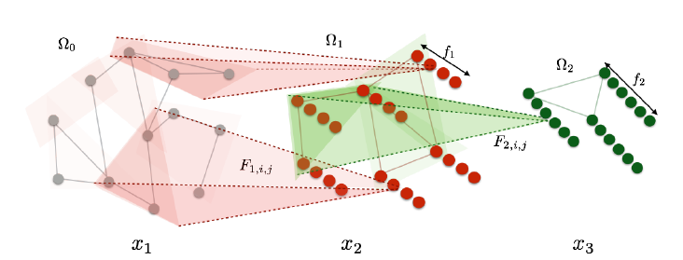
Spectral Network^{[1]}
将卷积推广到没有平移不变性的图结构上
CNN的优势来源于其对regular grid以下三个特征的利用
平移不变性：卷积核可以共享权值
Grid上的metric：紧支撑的卷积核
易于操作的多尺度聚类：减少后续层的参数
使用尽量少的参数量
[1]: J. Bruna, W. Zaremba, A. Szlam, and Y. LeCun. Spectral Networks and Deep Locally Connected Networks on Graphs. NIPS2014
Notes:
Metric is important, in a word, metric decides pattern. Think about the difference between different people’s appearances, they share common abstract features, but the distance and size of them make they look different.

Slide 16
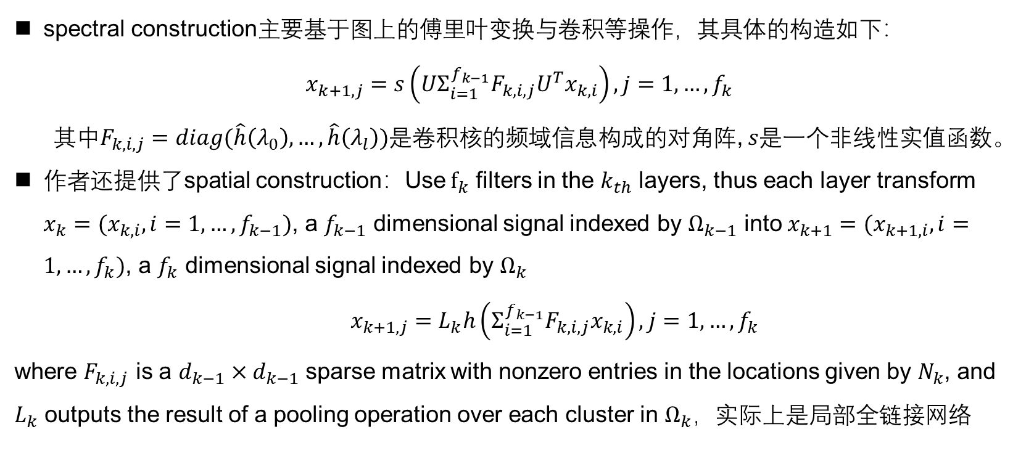
Spectral Network^{[1]}
spectral construction主要基于图上的傅里叶变换与卷积等操作，其具体的构造如下：
$$x_{k+1,j}=s\left(UΣ_{i=1}^{f_{k−1}}F_{k,i,j}U^{T}x_{k,i}\right),j=1,…,f_{k}$$
其中$F_{k,i,j}=diag(\hat{h}\left(λ_{0}\right),…,\hat{h}\left(λ_{l}\right))$是卷积核的频域信息构成的对角阵, $s$是一个非线性实值函数。
作者还提供了spatial construction：Use $f_{k}$ filters in the $k_{th}$ layers, thus each layer transform $x_{k}=(x_{k,i},i=1,…,f_{k−1})$, a $f_{k−1}$ dimensional signal indexed by $Ω_{k−1}$ into $x_{k+1}=(x_{k+1,i},i=1,…,f_{k})$, a $f_{k}$ dimensional signal indexed by $Ω_{k}$
$x_{k+1,j}=L_{k}h\left(Σ_{i=1}^{f_{k−1}}F_{k,i,j}x_{k,i}\right),j=1,…,f_{k}$
where $F_{k,i,j}$ is a $d_{k−1}×d_{k−1}$ sparse matrix with nonzero entries in the locations given by $N_{k}$, and $L_{k}$ outputs the result of a pooling operation over each cluster in $Ω_{k}，$实际上是局部全链接网络
[1]: J. Bruna, W. Zaremba, A. Szlam, and Y. LeCun. Spectral Networks and Deep Locally Connected Networks on Graphs. NIPS2014
Notes:
Metric is important, in a word, metric decides pattern. Think about the difference between different people’s appearances, they share common abstract features, but the distance and size of them make they look different.

Slide 17
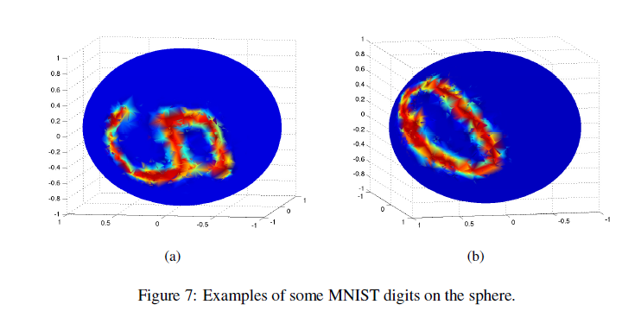
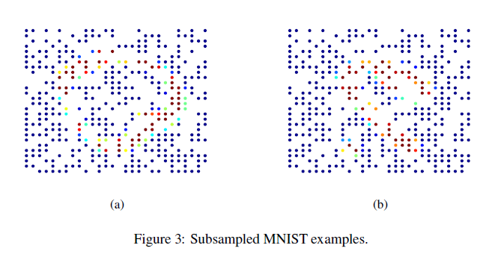
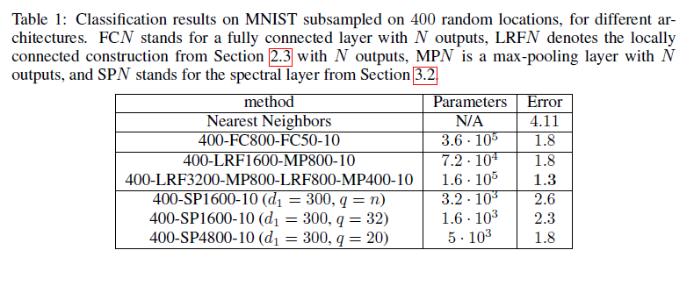
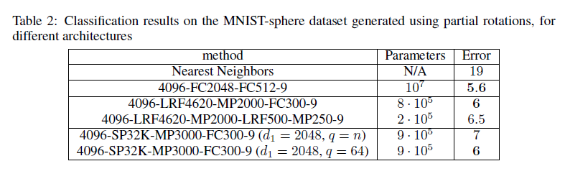
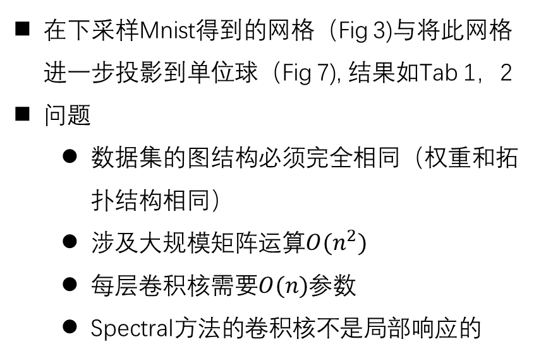
Spectral Network^{[1]}
在下采样Mnist得到的网格（Fig 3)与将此网格进一步投影到单位球（Fig 7), 结果如Tab 1，2
问题
数据集的图结构必须完全相同（权重和拓扑结构相同）
涉及大规模矩阵运算$O(n^{2})$
每层卷积核需要$O(n)$参数
Spectral方法的卷积核不是局部响应的
[1]: J. Bruna, W. Zaremba, A. Szlam, and Y. LeCun. Spectral Networks and Deep Locally Connected Networks on Graphs. NIPS2014
Notes:
Metric is important, in a word, metric decides pattern. Think about the difference between different people’s appearances, they share common abstract features, but the distance and size of them make they look different.

Slide 18
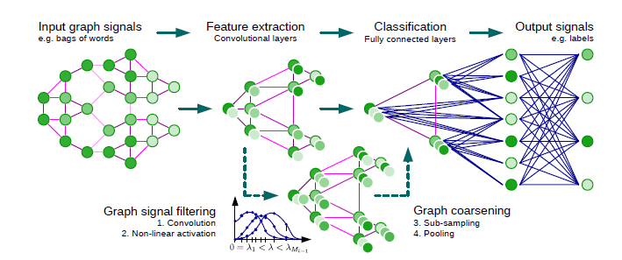
ChebNet^{[2]}
构建局部响应卷积核，同时减少参数量
频域上的K次多项式卷积核与局部全链接网络等价
加速前向与后向运算效率
利用Chebyshev多项式的迭代性质
[2]: Michaël Defferrard, Xavier Bresson, Pierre Vandergheynst. Convolutional Neural Networks on Graphs with Fast Localized Spectral Filtering. NIPS2016
Notes:
Metric is important, in a word, metric decides pattern. Think about the difference between different people’s appearances, they share common abstract features, but the distance and size of them make they look different.

Slide 19
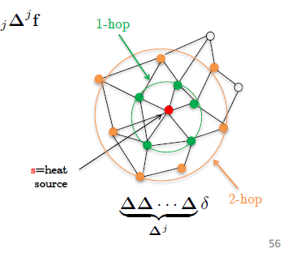
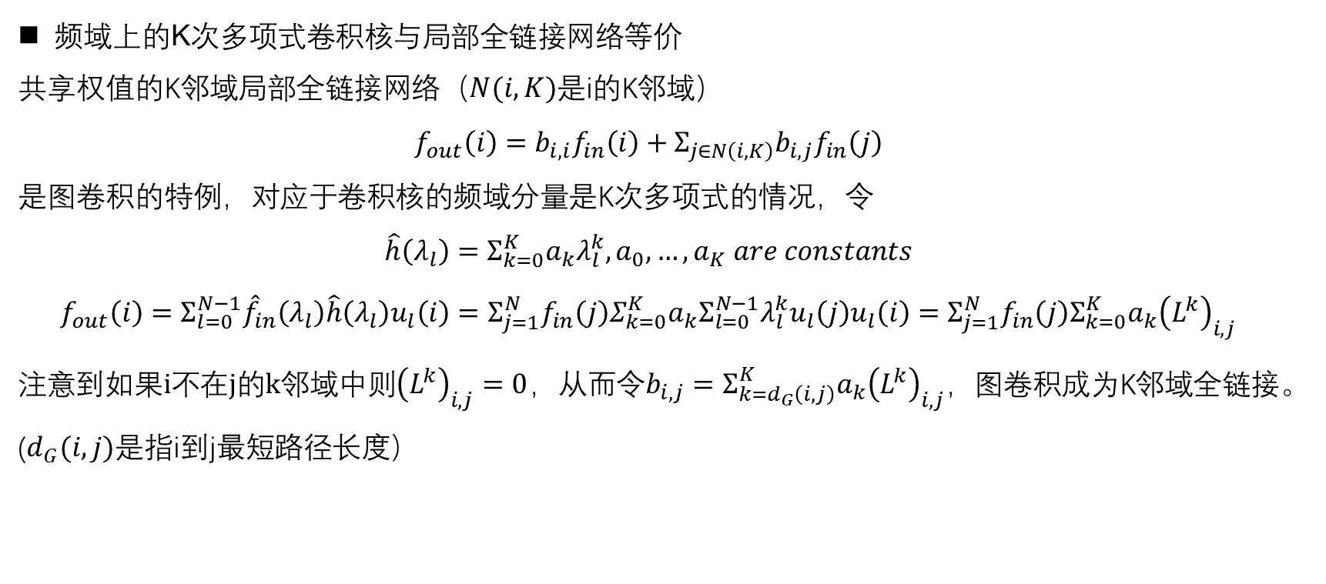
ChebNet^{[2]}
频域上的K次多项式卷积核与局部全链接网络等价
共享权值的K邻域局部全链接网络（$N(i,K)$是i的K邻域）
$$f_{out}\left(i\right)=b_{i,i}f_{in}\left(i\right)+Σ_{j∈N\left(i,K\right)}b_{i,j}f_{in}\left(j\right)$$
是图卷积的特例，对应于卷积核的频域分量是K次多项式的情况，令
$$\hat{h}\left(λ_{l}\right)=Σ_{k=0}^{K}a_{k}λ_{l}^{k},a_{0},…,a_{K} are constants$$
$$f_{out}\left(i\right)=Σ_{l=0}^{N−1}{\hat{f}}_{in}\left(λ_{l}\right)\hat{h}\left(λ_{l}\right)u_{l}\left(i\right)=Σ_{j=1}^{N}f_{in}\left(j\right)Σ_{k=0}^{K}a_{k}Σ_{l=0}^{N−1}λ_{l}^{k}u_{l}\left(j\right)u_{l}\left(i\right)=Σ_{j=1}^{N}f_{in}\left(j\right)Σ_{k=0}^{K}a_{k}{\left(L^{k}\right)}_{i,j}$$
注意到$如果i不在j的k邻域中则{\left(L^{k}\right)}_{i,j}=0$，从而令$b_{i,j}=Σ_{k=d_{G}\left(i,j\right)}^{K}a_{k}{\left(L^{k}\right)}_{i,j}，$图卷积成为K邻域全链接。($d_{G}(i,j)$是指i到j最短路径长度）
[2]: Michaël Defferrard, Xavier Bresson, Pierre Vandergheynst. Convolutional Neural Networks on Graphs with Fast Localized Spectral Filtering. NIPS2016
Notes:
Metric is important, in a word, metric decides pattern. Think about the difference between different people’s appearances, they share common abstract features, but the distance and size of them make they look different.

Slide 20
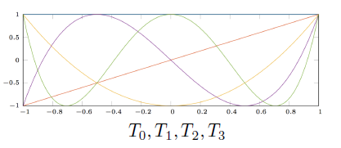
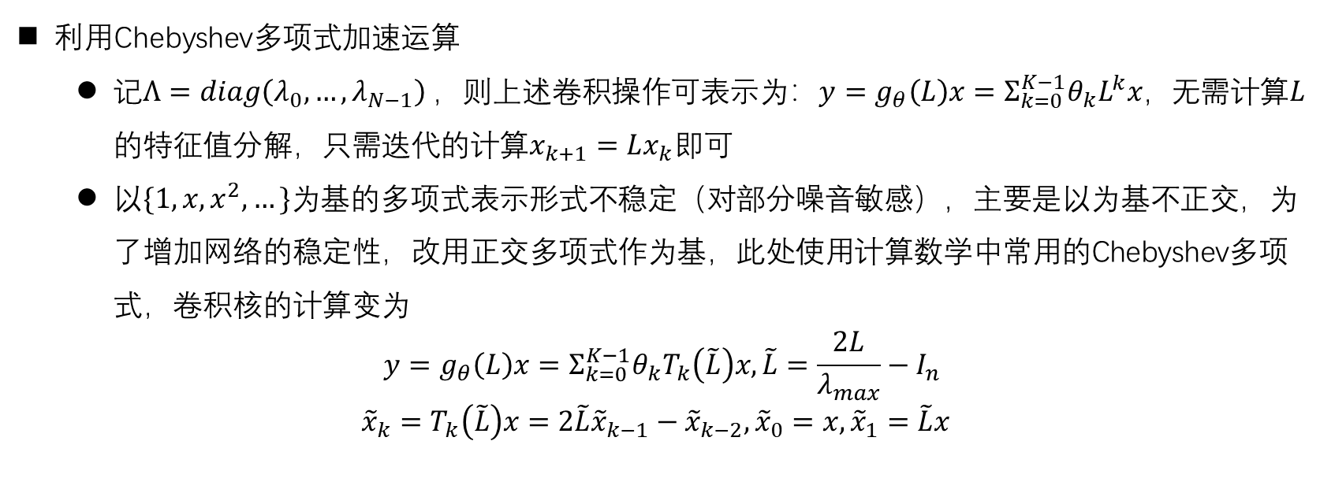
ChebNet^{[2]}
利用Chebyshev多项式加速运算
记$Λ=diag\left(λ_{0},…,λ_{N−1}\right)$，则上述卷积操作可表示为：$y=g_{θ}\left(L\right)x=Σ_{k=0}^{K−1}θ_{k}L^{k}x，$无需计算$L$的特征值分解，只需迭代的计算$x_{k+1}=Lx_{k}即可$
以$\{1,x,x^{2},…\}为$基的多项式表示形式不稳定（对部分噪音敏感），主要是以为基不正交，为了增加网络的稳定性，改用正交多项式作为基，此处使用计算数学中常用的Chebyshev多项式，卷积核的计算变为
$$y=g_{θ}\left(L\right)x=Σ_{k=0}^{K−1}θ_{k}T_{k}\left(\tilde{L}\right)x,\tilde{L}=\frac{2L}{λ_{max}}−I_{n}$$
$${\tilde{x}}_{k}=T_{k}\left(\tilde{L}\right)x=2\tilde{L}{\tilde{x}}_{k−1}−{\tilde{x}}_{k−2},{\tilde{x}}_{0}=x,{\tilde{x}}_{1}=\tilde{L}x$$
[2]: Michaël Defferrard, Xavier Bresson, Pierre Vandergheynst. Convolutional Neural Networks on Graphs with Fast Localized Spectral Filtering. NIPS2016
Notes:
Metric is important, in a word, metric decides pattern. Think about the difference between different people’s appearances, they share common abstract features, but the distance and size of them make they look different.

Slide 21
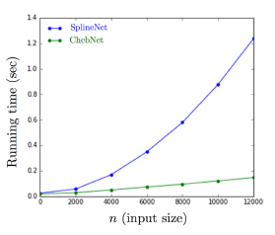
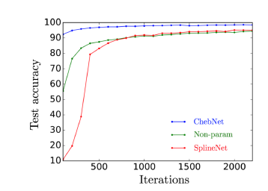
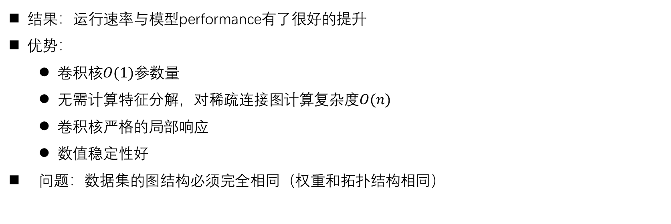
ChebNet^{[2]}
结果：运行速率与模型performance有了很好的提升
优势：
$卷积核O(1)参数量$
无需计算特征分解，对稀疏连接图计算复杂度$O(n)$
卷积核严格的局部响应
数值稳定性好
问题：数据集的图结构必须完全相同（权重和拓扑结构相同）
[2]: Michaël Defferrard, Xavier Bresson, Pierre Vandergheynst. Convolutional Neural Networks on Graphs with Fast Localized Spectral Filtering. NIPS2016
Notes:
Metric is important, in a word, metric decides pattern. Think about the difference between different people’s appearances, they share common abstract features, but the distance and size of them make they look different.

Slide 22
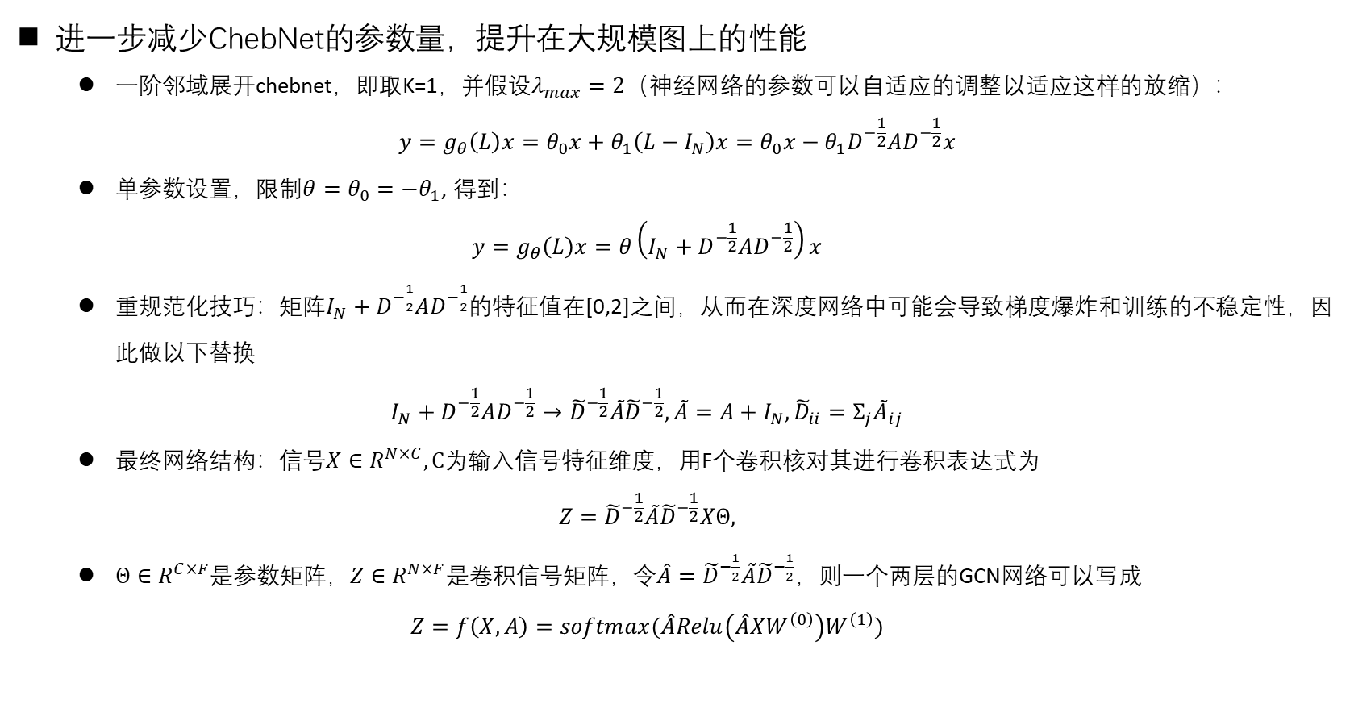
1stChebNet^{[3]}
进一步减少ChebNet的参数量，提升在大规模图上的性能
一阶邻域展开chebnet，即取K=1，并假设$λ_{max}=2（$神经网络的参数可以自适应的调整以适应这样的放缩）：
$$y=g_{θ}\left(L\right)x=θ_{0}x+θ_{1}\left(L−I_{N}\right)x=θ_{0}x−θ_{1}D^{−\frac{1}{2}}AD^{−\frac{1}{2}}x$$
单参数设置，限制$θ=θ_{0}=−θ_{1}$, 得到：
$$y=g_{θ}\left(L\right)x=θ\left(I_{N}+D^{−\frac{1}{2}}AD^{−\frac{1}{2}}\right)x$$
重规范化技巧：矩阵$I_{N}+D^{−\frac{1}{2}}AD^{−\frac{1}{2}}$的特征值在[0,2]之间，从而在深度网络中可能会导致梯度爆炸和训练的不稳定性，因此做以下替换
$$I_{N}+D^{−\frac{1}{2}}AD^{−\frac{1}{2}}→{\tilde{D}}^{−\frac{1}{2}}\tilde{A}{\tilde{D}}^{−\frac{1}{2}},\tilde{A}=A+I_{N},{\tilde{D}}_{ii}=Σ_{j}{\tilde{A}}_{ij}$$
最终网络结构：信号$X∈R^{N×C}, C$为输入信号特征维度，用F个卷积核对其进行卷积表达式为
$$Z={\tilde{D}}^{−\frac{1}{2}}\tilde{A}{\tilde{D}}^{−\frac{1}{2}}XΘ,$$
$Θ∈R^{C×F}$是参数矩阵，$Z∈R^{N×F}$是卷积信号矩阵，令$\hat{A}={\tilde{D}}^{−\frac{1}{2}}\tilde{A}{\tilde{D}}^{−\frac{1}{2}}$，则一个两层的GCN网络可以写成
$$Z=f\left(X,A\right)=softmax(\hat{A}Relu\left(\hat{A}XW^{\left(0\right)}\right)W^{\left(1\right)})$$
[3]: Thomas N. Kipf, Max Welling. SEMI-SUPERVISED CLASSIFICATION WITH GRAPH CONVOLUTIONAL NETWORKS. ICLR2017
Notes:
Metric is important, in a word, metric decides pattern. Think about the difference between different people’s appearances, they share common abstract features, but the distance and size of them make they look different.

Slide 23
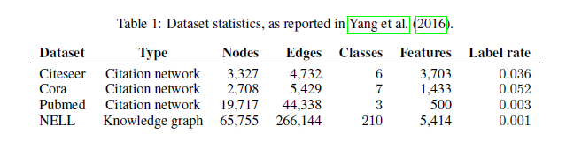
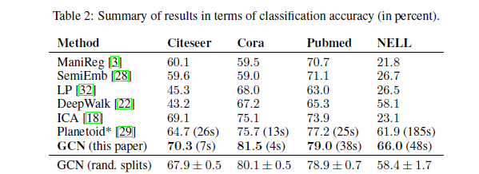
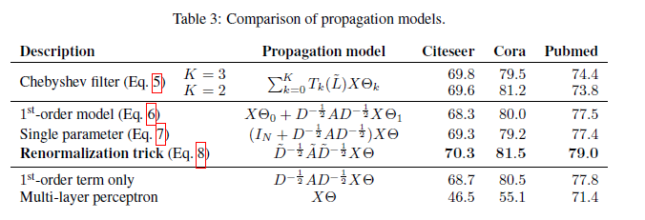
1stChebNet^{[3]}
结果：在大规模图上取得了很好的结果
问题：数据集的图结构必须完全相同（权重和拓扑结构相同）
[3]: Thomas N. Kipf, Max Welling. SEMI-SUPERVISED CLASSIFICATION WITH GRAPH CONVOLUTIONAL NETWORKS. ICLR2017
Notes:
Metric is important, in a word, metric decides pattern. Think about the difference between different people’s appearances, they share common abstract features, but the distance and size of them make they look different.

Slide 24
Summary
优势
拥有坚实的数学理论和很好的数学性质
实现了较低计算代价的图卷积
挑战
虽然有一系列工作研究如何使spectral网络通用于不同的图，但尚缺乏大的突破
无法处理有向图
无法处理边的特征
Chebnet与1stchebnet虽然在原理上是局部的，但是实现时必须一次性读入图的所有节点，在处理大规模数据时效率低下
Notes:
Metric is important, in a word, metric decides pattern. Think about the difference between different people’s appearances, they share common abstract features, but the distance and size of them make they look different.

Slide 25
Outline
Part 0: GCN的发展经过
Part 1: Spectral方法
Spectral Graph Theory
Graph convolution
Graph coarsening
Spectral ConvNets
Part 2: Spatial方法
Part 3: GCN与transfer learning

Slide 26
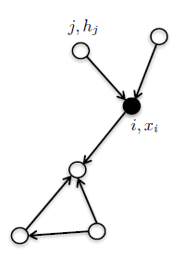
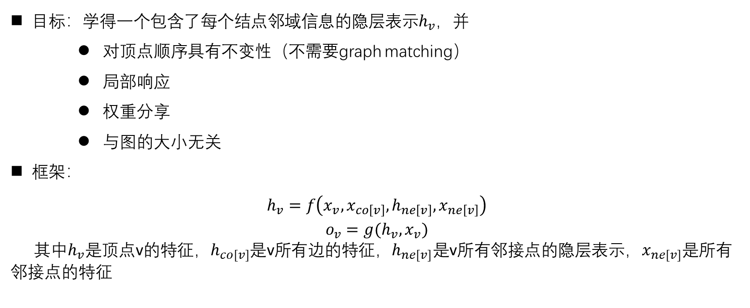
Framework
目标：学得一个包含了每个结点邻域信息的隐层表示$h_{v}$，并
对顶点顺序具有不变性（不需要graph matching）
局部响应
权重分享
与图的大小无关
框架：
$$h_{v}=f\left(x_{v},x_{co\left[v\right]},h_{ne\left[v\right]},x_{ne\left[v\right]}\right)$$
$$o_{v}=g(h_{v},x_{v})$$
其中$h_{v}是$顶点v的特征，$h_{co[v]}$是v所有边的特征，$h_{ne[v]}是$v所有邻接点的隐层表示，$x_{ne[v]}$是所有邻接点的特征
Notes:
Metric is important, in a word, metric decides pattern. Think about the difference between different people’s appearances, they share common abstract features, but the distance and size of them make they look different.

Slide 27
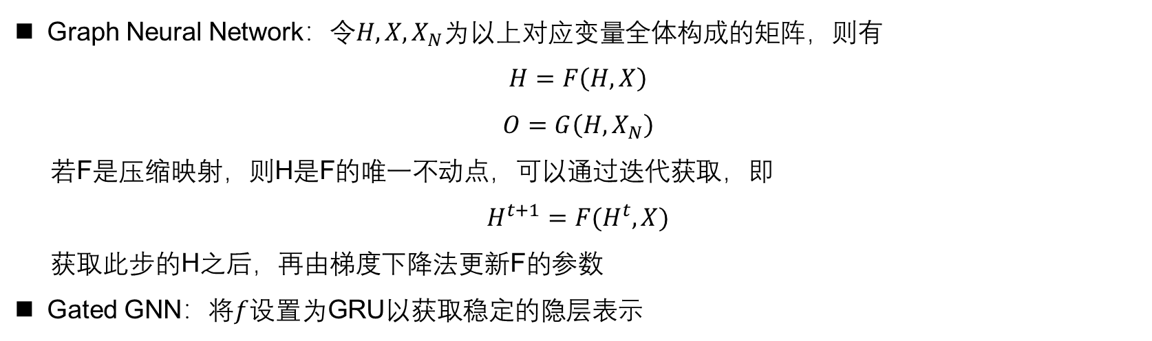
Recurrent-based Methods
Graph Neural Network：令$H,X,X_{N}$为以上对应变量全体构成的矩阵，则有
$$H=F\left(H,X\right)$$
$$O=G\left(H,X_{N}\right)$$
若F是压缩映射，则H是F的唯一不动点，可以通过迭代获取，即
$$H^{t+1}=F(H^{t},X)$$
获取此步的H之后，再由梯度下降法更新F的参数
Gated GNN：将$f$设置为GRU以获取稳定的隐层表示
Notes:
Metric is important, in a word, metric decides pattern. Think about the difference between different people’s appearances, they share common abstract features, but the distance and size of them make they look different.

Slide 28
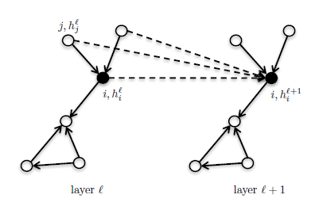
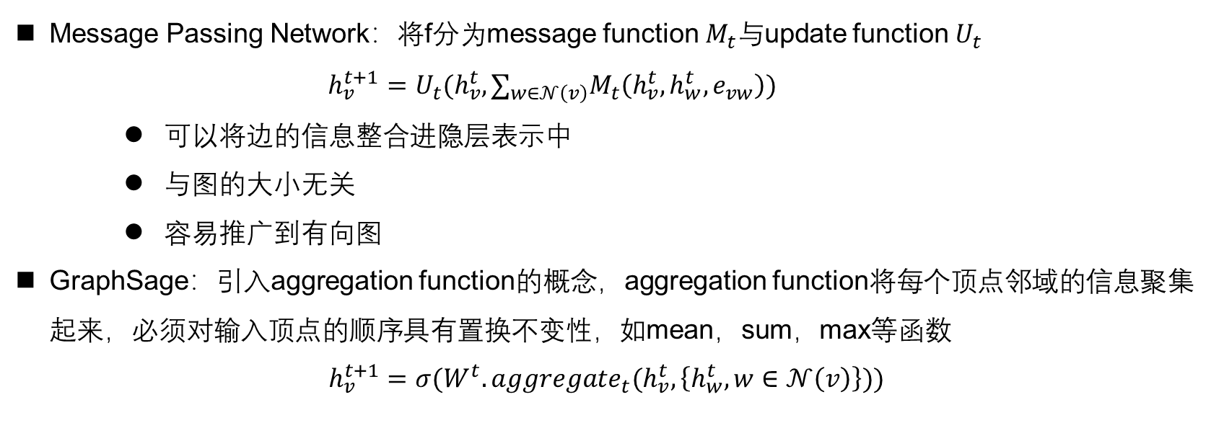
Composition Based Methods
Message Passing Network：将f分为message function${ M}_{t}与$update function${ U}_{t}$
$$h_{v}^{t+1}=U_{t}({h_{v}^{t},∑}_{w∈𝒩\left(v\right)}M_{t}\left(h_{v}^{t},h_{w}^{t},e_{vw}\right))$$
可以将边的信息整合进隐层表示中
与图的大小无关
容易推广到有向图
GraphSage：引入aggregation function的概念，aggregation function将每个顶点邻域的信息聚集起来，必须对输入顶点的顺序具有置换不变性，如mean，sum，max等函数
$$h_{v}^{t+1}=σ(W^{t}.aggregate_{t}(h_{v}^{t},\left\{h_{w}^{t},w∈𝒩\left(v\right)\right\}))$$
Notes:
Metric is important, in a word, metric decides pattern. Think about the difference between different people’s appearances, they share common abstract features, but the distance and size of them make they look different.

Slide 29
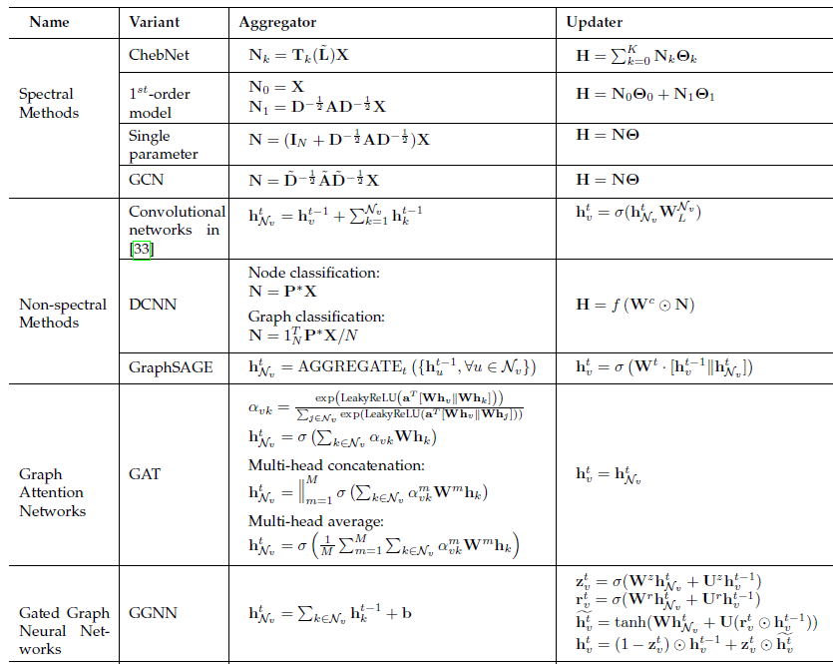
Summary
多数的应用使用的是spatial GCN
对图结构的要求大大的降低
主要的出发点是汇聚图中的信息到中心结点上
大多数工作可以被归纳入MPNN的框架中
缺乏可解释性
隐式的嵌入了图的结构信息，对图结构的利用和强调不如spectral方法
Notes:
Metric is important, in a word, metric decides pattern. Think about the difference between different people’s appearances, they share common abstract features, but the distance and size of them make they look different.

Slide 30
Outline
Part 0: GCN的发展经过
Part 1: Spectral方法
Spectral Graph Theory
Graph convolution
Graph coarsening
Spectral ConvNets
Part 2: Spatial方法
Part 3: GCN与transfer learning

Slide 31
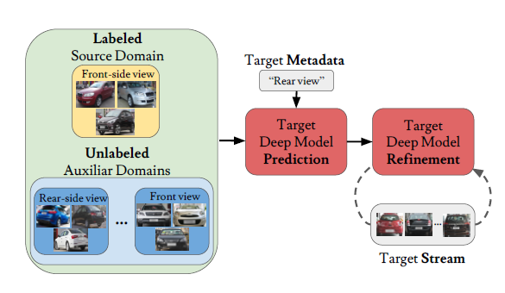
AdaGraph^{[4]}
本文提出了一种利用metadata构成的图来进行predictive transfer learning的方法
predictive transfer learning：target domain既没有label也没有data，但是有labeled source domain和有data无label的辅助domain，以及各个domain的metadata
[4]: M. Mancini, S. Bulo, B. Caputo, E. Ricci. AdaGraph: Unifying Predictive and Continuous Domain Adaptation through Graphs. CVPR2019(oral)
Notes:
Metric is important, in a word, metric decides pattern. Think about the difference between different people’s appearances, they share common abstract features, but the distance and size of them make they look different.

Slide 32
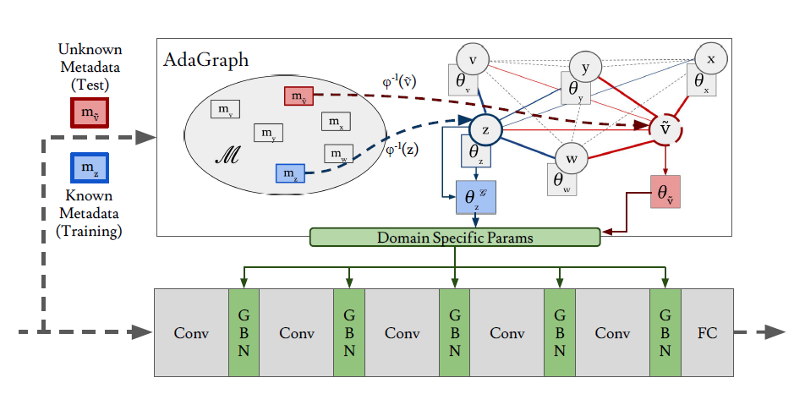
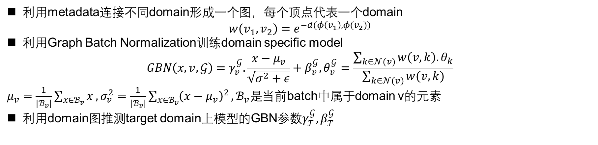
AdaGraph^{[4]}
利用metadata连接不同domain形成一个图，每个顶点代表一个domain
$$w\left(v_{1},v_{2}\right)=e^{−d(φ\left(v_{1}\right),φ(v_{2}))}$$
利用Graph Batch Normalization训练domain specific model
$$GBN\left(x,v,𝒢\right)=γ_{v}^{𝒢}.\frac{x−μ_{v}}{\sqrt{σ^{2}+ε}}+β_{v}^{𝒢},θ_{v}^{𝒢}=\frac{\sum_{k∈𝒩(v)}{w\left(v,k\right).θ_{k}}}{\sum_{k∈𝒩(v)}{w(v,k)}}$$
$μ_{v}=\frac{1}{|ℬ_{v}|}\sum_{x∈ℬ_{v}}{x},σ_{v}^{2}=\frac{1}{|ℬ_{v}|}\sum_{x∈ℬ_{v}}{{\left(x−μ_{v}\right)}^{2}},ℬ_{v}是$当前batch中属于domain v的元素
利用domain图推测target domain上模型的GBN参数$γ_{𝒯}^{𝒢},β_{𝒯}^{𝒢}$
[4]: M. Mancini, S. Bulo, B. Caputo, E. Ricci. AdaGraph: Unifying Predictive and Continuous Domain Adaptation through Graphs. CVPR2019(oral)
Notes:
Metric is important, in a word, metric decides pattern. Think about the difference between different people’s appearances, they share common abstract features, but the distance and size of them make they look different.

Slide 33
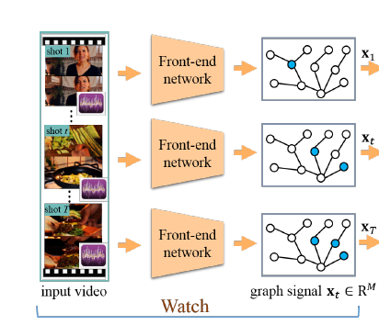
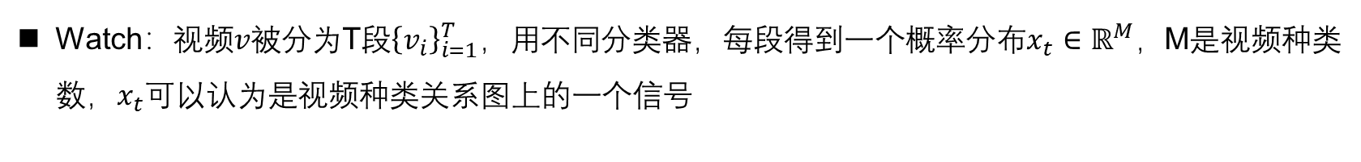
Watch, Think, and Attend^{[5]}
Watch：视频$v$被分为T段${\left\{v_{i}\right\}}_{i=1}^{T}$，用不同分类器，每段得到一个概率分布$x_{t}∈ℝ^{M}，$M是视频种类数，$x_{t}$可以认为是视频种类关系图上的一个信号
[5]: J. Gao, T. Zhang, C. Xu. Watch, Think and Attend: End-to-End Video Classification via Dynamic Knowledge Evolution Modeling. MM2018
Notes:
Metric is important, in a word, metric decides pattern. Think about the difference between different people’s appearances, they share common abstract features, but the distance and size of them make they look different.

Slide 34










Watch, Think, and Attend^{[5]}
Think：
利用LSTM网络对时间序列语义的总结能力得到全局的类别表示
利用GCN对图结构信息的特征抽取能力，抽取融合了类别关系信息的局部特征供LSTM网络使用
$$h_{t}$$
$$c_{t−1}$$
$$c_{t}$$
×
+
$$o_{t}$$
$$tanh$$
$$f_{t}$$
$$i_{t}$$
×
×
$$g_{t}$$
$$σ$$
$$σ$$
$$tanh$$
$$σ$$
$$h_{t}$$
$$h_{t−1}$$
GCN
GCN
GCN
GCN
$$x_{t}$$
[5]: J. Gao, T. Zhang, C. Xu. Watch, Think and Attend: End-to-End Video Classification via Dynamic Knowledge Evolution Modeling. MM2018
Notes:
Metric is important, in a word, metric decides pattern. Think about the difference between different people’s appearances, they share common abstract features, but the distance and size of them make they look different.

Slide 35

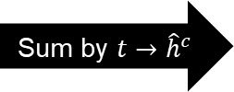




















Watch, Think, and Attend^{[5]}
Attend：使用Graph Attention网络强化重要类别的信息
$$h_{t}$$
3
$$p$$
1
$$×w$$
$${×w}_{1}$$
$$p^{1}$$
softmax
$$a_{t}^{1}$$
1
2
4
$$p^{2}$$
3
$$p^{3}$$
4
$${×w}_{2}$$
5
Sum by $t→{\hat{h}}^{c}$
$$p^{4}$$
$$×w$$
2
classifier
$$a_{t}^{2}$$
$$h_{t}$$
$${\hat{h}}^{c}=\sum_{i=1}^{T}{\sum_{m∈𝒩(c)}{{[a}_{t}^{c}]_{m}{\left[h_{t}\right]}_{m}}}$$
$$p^{c}=f({\hat{h}}^{c};w_{c})$$
5
softmax
7
$$p^{5}$$
6
$$p^{6}$$
7
$$p^{7}$$
$$×w$$
$${×w}_{6}$$
6
8
softmax
$$a_{t}^{6}$$
$$p^{8}$$
8
[5]: J. Gao, T. Zhang, C. Xu. Watch, Think and Attend: End-to-End Video Classification via Dynamic Knowledge Evolution Modeling. MM2018
Notes:
Metric is important, in a word, metric decides pattern. Think about the difference between different people’s appearances, they share common abstract features, but the distance and size of them make they look different.

Slide 36
Watch, Think, and Attend^{[5]}
Attend：使用Graph Attention网络强化重要类别的信息
$$h_{t}$$
3
$$p$$
1
$$×w$$
$${×w}_{1}$$
$$p^{1}$$
softmax
$$a_{t}^{1}$$
1
2
4
$$p^{2}$$
3
$$p^{3}$$
4
$${×w}_{2}$$
5
Sum by $t→{\hat{h}}^{c}$
$$p^{4}$$
$$×w$$
2
classifier
$$a_{t}^{2}$$
$$h_{t}$$
$${\hat{h}}^{c}=\sum_{i=1}^{T}{\sum_{m∈𝒩(c)}{{[a}_{t}^{c}]_{m}{\left[h_{t}\right]}_{m}}}$$
$$p^{c}=f({\hat{h}}^{c};w_{c})$$
5
softmax
7
$$p^{5}$$
6
$$p^{6}$$
7
$$p^{7}$$
$$×w$$
$${×w}_{6}$$
6
8
softmax
$$a_{t}^{6}$$
$$p^{8}$$
8
[5]: J. Gao, T. Zhang, C. Xu. Watch, Think and Attend: End-to-End Video Classification via Dynamic Knowledge Evolution Modeling. MM2018
Notes:
Metric is important, in a word, metric decides pattern. Think about the difference between different people’s appearances, they share common abstract features, but the distance and size of them make they look different.

